Slide 1

Project Title -Seasonal Agriculture Performance Analysis
RIYA SINGH
[UNIVERSITY OF LUCKNOW ]
AICTE STU ID : STU6a4fa2b8edff21783603896

Slide 2

PROBLEM STATEMENT
(Agricultural activities are influenced by seasonal variations in environmental conditions, farming practices, resource availability and market conditions. As a result, agricultural performance may differ from one season to another. However, raw agricultural data does not clearly explain how agricultural performance changes across seasons or what patterns can be observed in different seasonal conditions. The problem is to analyze the given agricultural dataset and investigate seasonal differences in agricultural performance by identifying meaningful patterns, trends, relationships and variations within the available data.

Slide 3
Project Description Seasonal Agriculture Performance Analysis is a data analytics project that examines agricultural performance across Kharif, Rabi, and Zaid seasons. The project analyses crop yield, production, resource utilization, environmental conditions, water efficiency, and profitability to identify seasonal patterns, regional variations, significant relationships, and high-risk agricultural conditions. Using Python, statistical analysis, and data visualization, the project generates evidence-based insights and recommendations for improved agricultural planning and resource management.

Slide 4

WHO ARE THE END USERS?
Farmers
Agricultural planners / decision-makers
Agricultural researchers
Agricultural consultants
Government / agricultural departments

Slide 5

Technology Used
Python – Data analysis and processing
Pandas – Data cleaning, manipulation, and aggregation
NumPy – Numerical computations
Matplotlib – Data visualization
Seaborn – Statistical and analytical visualizations
SciPy – Statistical analysis
Google Colab – Project development and analysis
GitHub – Project version control and repository management

Slide 6
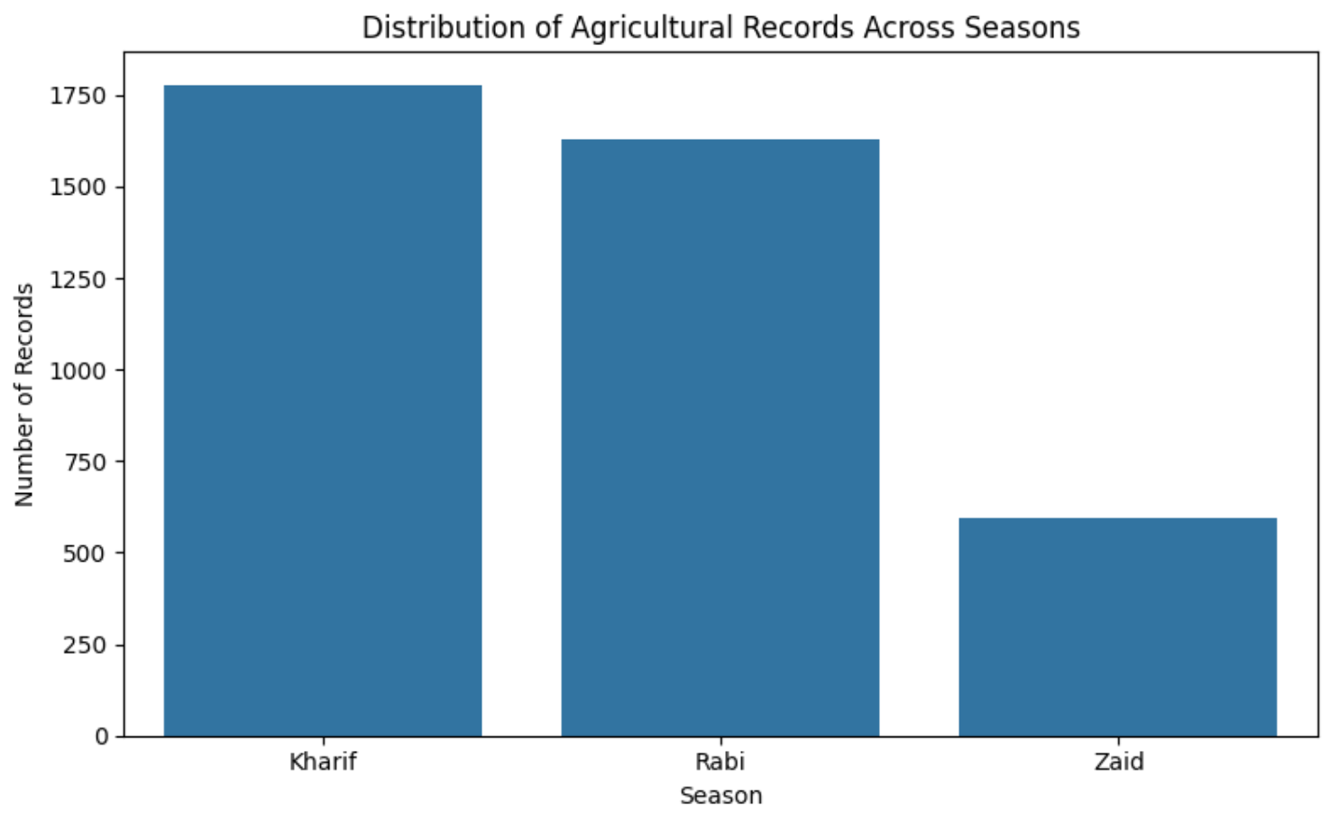
RESULTS

Slide 7
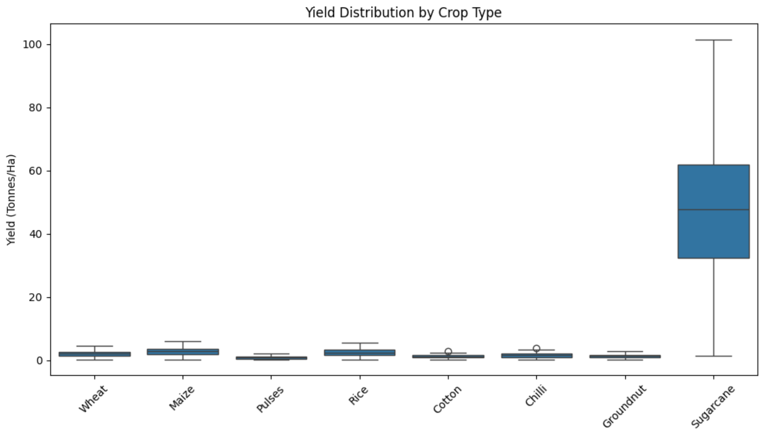
RESULTS
[Add screen shots of your code ]

Slide 8
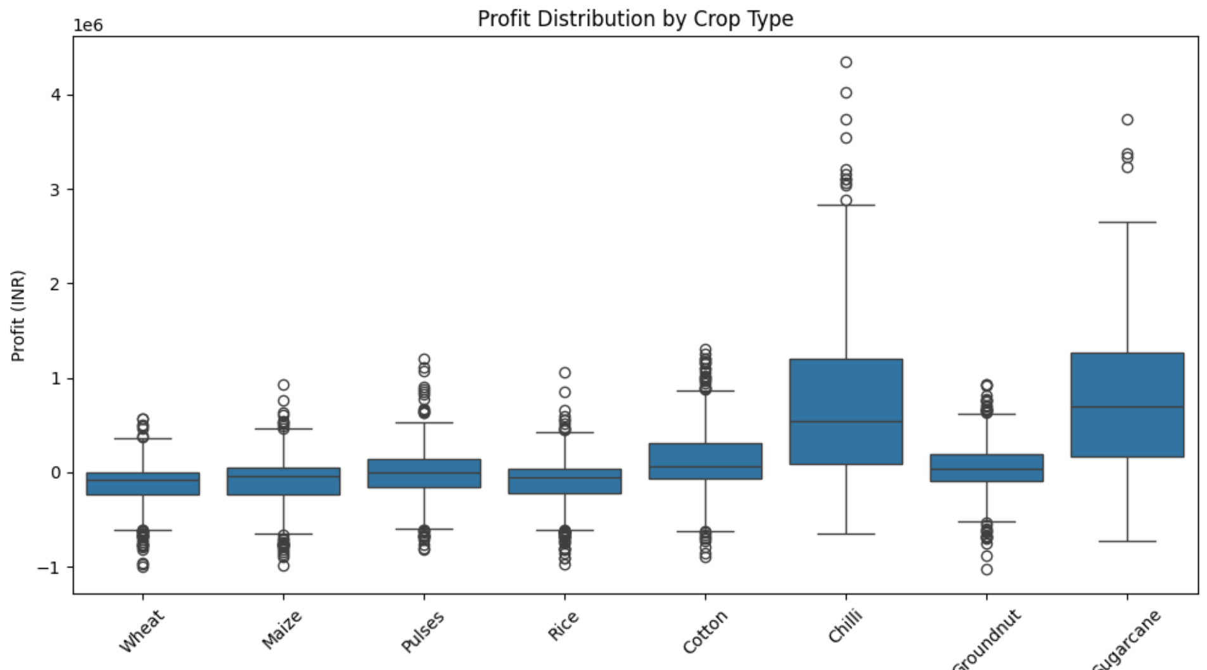
RESULTS
[Add screen shots of your code ]

Slide 9
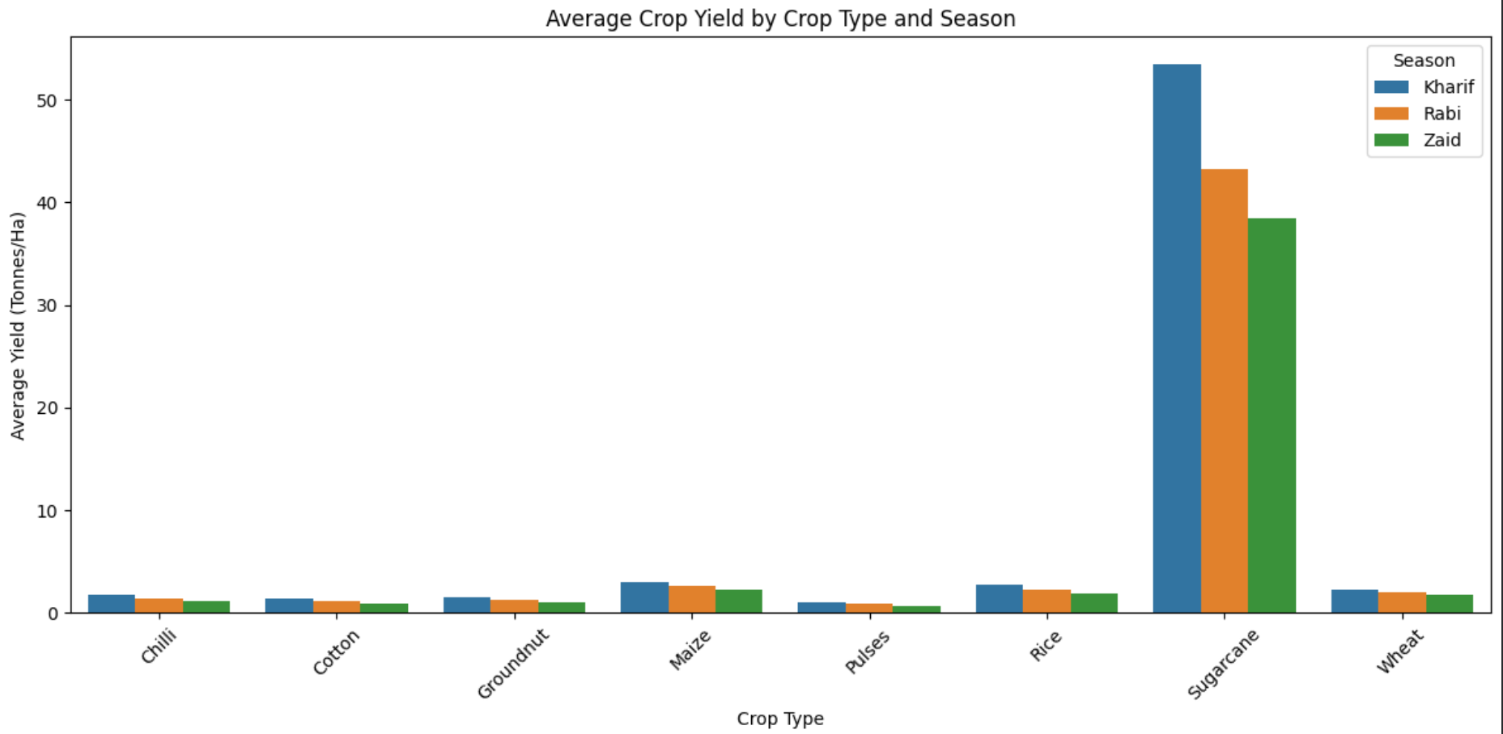
RESULTS
[Add screen shots of your code ]

Slide 10
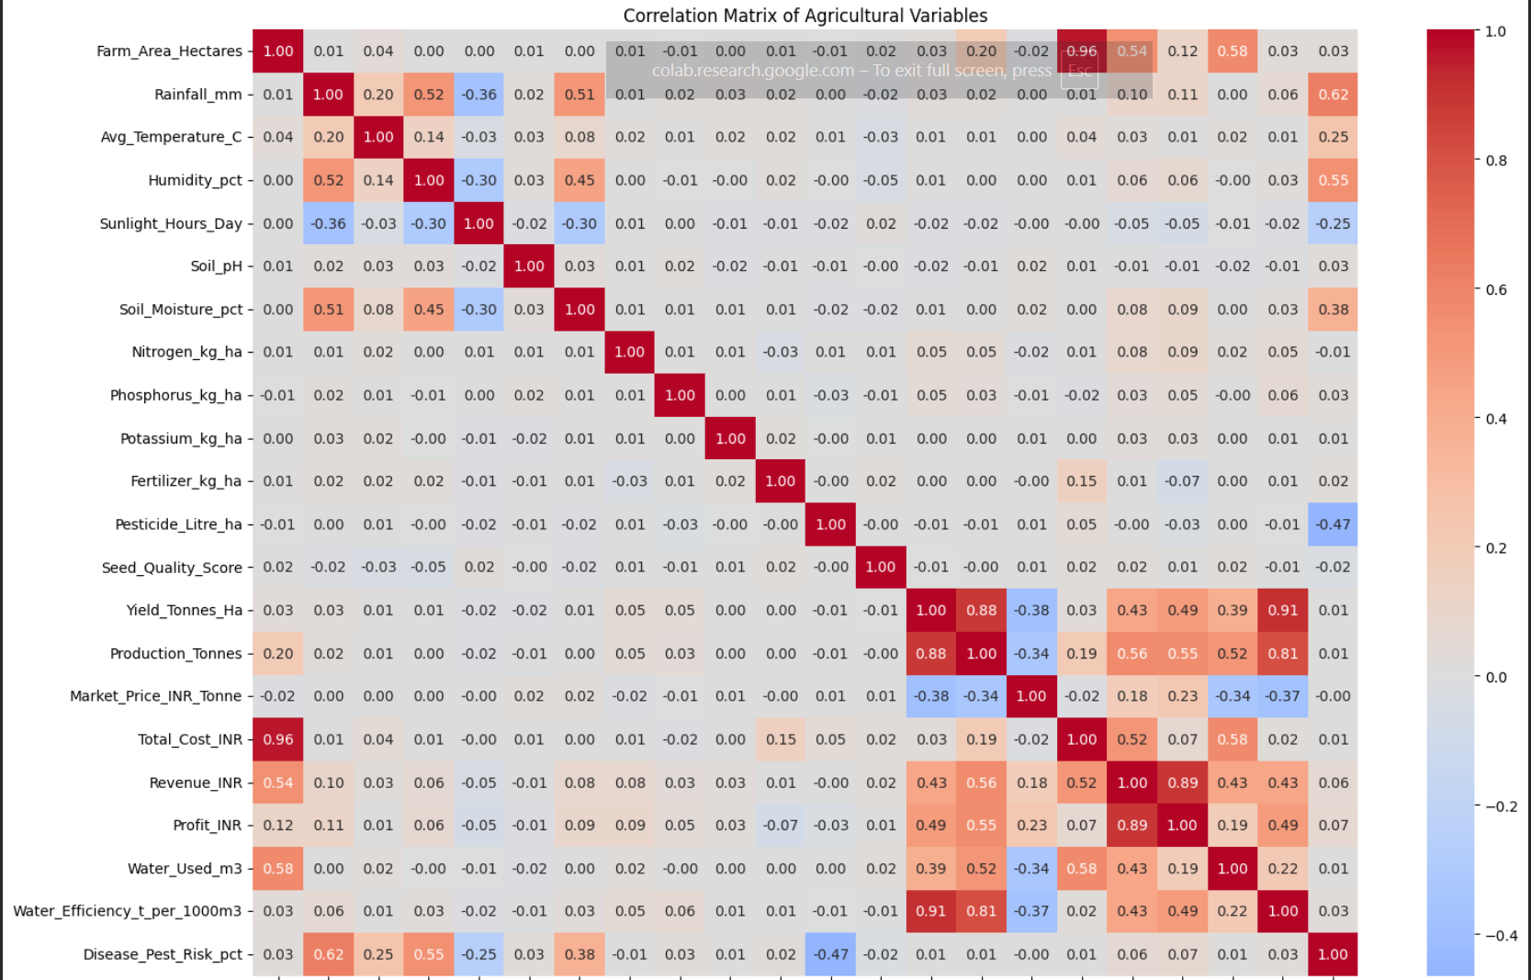
RESULTS
[Add screen shots of your code ]

Slide 11
Future scope
Real-time agricultural data integration for continuous monitoring of crops and environmental conditions.
Predictive analytics / Machine Learning to forecast crop yield, profitability, and seasonal performance.
Weather forecasting integration to support better crop and irrigation planning.
Crop recommendation system based on soil, weather, season, and market conditions.
Smart irrigation recommendations to improve water-use efficiency.
Interactive dashboard for farmers, agricultural planners, and decision-makers.
Larger and real-world datasets can be incorporated to improve the accuracy and generalizability of the analysis.

Slide 12
GitHub Link
https://github.com/ri-ya24/seasonal-agriculture-performance-analysis

Slide 13

VOIS Course completion certificate - Course name- Data Visualization

Slide 14
Thank you
.
.
Presented by: Riya Singh

